Slide 1
Growth of Functions, Input Length and Polynomial Solvability

Slide 2
Complexity of Problems or Algorithms
For every single problem, there could be numerous algorithms
We are interested in the complexities of algorithms (quality of the algorithms) as well as the complexity of problems (hardness of the problems)
merge sort
heap sort
bucket sort
quick sort
Sorting
shell sort
insertion sort
bubble sort

Slide 3
Analysis of Algorithms
Correctness of algorithm: For any valid input instance, the algorithm should correctly report the answer
Quality of algorithms
Time-efficiency (more critical) and space-efficiency
Asymptotic notations
Worst-case analysis
Average-case analysis
Amortized analysis
Level of hardness of problems
Undecidability
NP-completeness/NP-hardness
lower bound
Is your algorithm optimal for a specific problem?

Slide 4
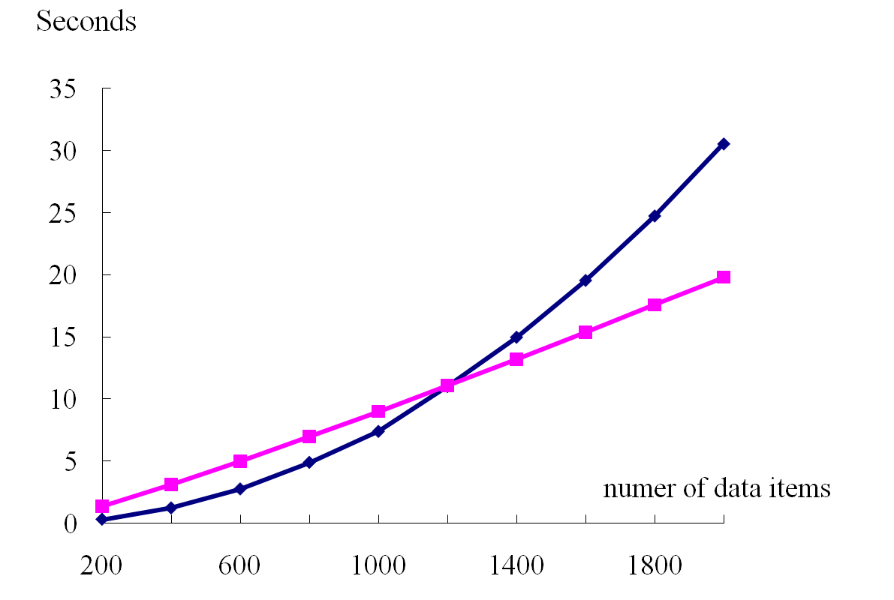
Comparison of two sorting algorithms implemented on two computers
Insertion sort
Quick sort

Slide 5
Asymptotic notation
Asymptotic efficiency of an algorithm
we are concerned with how the running time of an algorithm increases with the size of the input in the limit, as the size of the input increases without bound
Which one grows faster?
F₁(n) = 1000×n²
F₂(n) = 5×n³
F₃(n) = 10⁻⁸×2^{n}
In the asymptotic notion, the coefficient in the function is less relevant

Slide 6
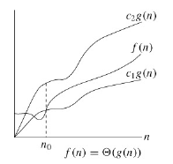
Θ-notation
For a given function g(n), we denote by Θ(g(n)) the set of functions Θ(g(n)) = {f(n) : there exist positive constants c₁, c₂, and n₀ such that 0 ≤ c₁g(n) ≤ f(n) ≤ c₂g(n) for all n ≥ n₀}
Function f(n) belongs to Θ(g(n)), denoted by f(n) = Θ(g(n)), if there exist positive constants c₁ and c₂ s.t. it can be "sandwiched" between c₁g(n) and c₂g(n), for sufficiently large n.

Slide 7
With asymptotic notations, the equal sign in means set membership f(n) = Θ(g(n)) rather than equality
Function f(n) belongs to the set defined by function g(n)

Slide 8
Examples
f(n)= ½n² - 3n
c₁n² ≤ ½ n² - 3n ≤ c₂n²
c₁ ≤ ½ - 3/n ≤ c₂
By choosing c₁ = 1/14, c₂ = 1/2, and n₀ = 7, we can verify that ½n² - 3n = Θ(n²)
Is n³ = Θ(n²)?
f(n) = an² + bn + c, where a, b, and c are constants and a>0
we take the constants c₁ = a/4, c₂ = 7a/4, and
0 ≤ c₁n² ≤ an² + bn + c ≤ c₂n² for all n ≥ n₀

Slide 9
Θ-notation
Every member f(n) ∈ Θ(g(n)) must be asymptotically nonnegative, that is, that f(n) be nonnegative whenever n is sufficiently large
For all n ≥ n₀, the function f(n) is equal to g(n) within a constant factor. We say that g(n) is an asymptotically tight bound for f(n).
The Θ-notation asymptotically bounds a function from above and below.
An informal notion of Θ-notation: Throwing away lower-order terms and ignoring the leading coefficient of the highest-order term ½n² - 3n = Θ(n²)
Any polynomial f(n) of degree d is in Θ(n^{d})

Slide 10
Asymptotic notation in equations and inequalities
2n² + 3n + 1 = 2n² + Θ(n) means that 2n² + f(n), where f(n) is some function in the set Θ(n)
Worst-case running time of merge sort as the recurrence: T(n) = 2T(n/2) + Θ(n)
2n² + Θ(n) = Θ(n²)
No matter how the anonymous functions are chosen on the left of the equal sign, there is a way to choose the anonymous functions on the right of the equal sign to make the equation valid

Slide 11
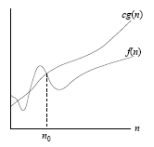
O-notation
Asymptotic upper bound: O(g(n)) the set of functions O(g(n)) = {f(n) : there exist positive constants c and n₀ such that 0 ≤ f(n) ≤ cg(n) for all n ≥ n₀}
What does “the running time of quick sort is O(n²)” mean?

Slide 12
O-notation
“the running time of quick sort is O(n²)”
There is a function f(n) that is O(n²) such that for any value of n, no matter what particular input of size n is chosen, the running time on that input is bounded from above by the value g(n). Equivalently, we mean that the worst-case running time is O(n²).

Slide 13
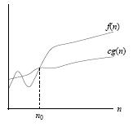
Ω-notation
Asymptotic lower bound: Ω(g(n)) the set of functions Ω(g(n)) = {f(n) : there exist positive constants c and n₀ such that 0 ≤ cg(n) ≤ f(n) for all n ≥ n₀}
Theorem 3.1: For any two functions f(n) and g(n), we have f(n) = Θ(g(n)) if and only if f(n) = O(g(n)) and f(n) = Ω(g(n)).

Slide 14
Ω-notation
“The running time of some algorithm is Ω(g(n)).”
No matter what particular input of size n is chosen for each value of n, the running time on that input is at least a constant times g(n), for sufficiently large n.
“The running time of insertion sort falls between Ω(n) and O(n²), since it falls anywhere between a linear function of n and a quadratic function of n.

Slide 15
o-notation
O(n) is NOT asymptotically tight: 2n = O(n²)
o(g(n)) = {f(n) : for any constant c, there exists n₀ such that 0 ≤ f(n) < cg(n) for all n ≥ n₀}
E.g. 2n = o(n²), but 2n² ≠ o(n²)
f(n) = o(g(n)) intuitively means that

Slide 16
ω-notation
ω(g(n)) = {f(n) : for any constant c, there exists n₀ such that 0 ≤ cg(n) < f(n) for all n ≥ n₀}
E.g. n²/2 = ω(n), but n²/2 ≠ ω(n²)
f(n) = ω(g(n)) intuitively means that
f(n) is in ω(g(n)) if and only if g(n) is in ο(f(n))

Slide 17
Comparing Functions
Transitivity:
f(n) = Θ(g(n)) and g(n) = Θ(h(n)) imply f(n) = Θ(h(n)),
f(n) = O(g(n)) and g(n) = O(h(n)) imply f(n) = O(h(n)),
f(n) = Ω(g(n)) and g(n) = Ω(h(n)) imply f(n) = Ω(h(n)),
f(n) = o(g(n)) and g(n) = o(h(n)) imply f(n) = o(h(n)),
f(n) = ω(g(n)) and g(n) = ω(h(n)) imply f(n) = ω(h(n)).
Reflexibility:
f(n) = Θ(f(n)),
f(n) = O(f(n)),
f(n) = Ω(f(n)).

Slide 18
Comparing Functions
Symmetry:
f(n) = O(g(n)) if and only if g(n) = Ω(f(n)),
f(n) = o(g(n)) if and only if g(n) = ω(f(n)).
Transpose Symmetry:
f(n) = O(g(n)) ≈ a ≤ b,
f(n) = Ω(g(n)) ≈ a ≥ b,
f(n) = Θ(g(n)) ≈ a = b,
f(n) = o(g(n)) ≈ a < b,
f(n) = ω(g(n)) ≈ a > b.

Slide 19
Computing time functions
O(1) < O(log n) < O(n) < O(n log n) < O(n²) < O(n³) < O(2^{n}) < O(n!) < O(n^{n})
polynomial algorithm
exponential algorithm: O(2^{n})
Algorithm A : O(n³), algorithm B : O(n)
Should Algorithm B run faster than A?
Not necessarily !
It is true only when n is large enough!

Slide 20
What does “polynomial” in “The running time of algorithm A is polynomial.” mean?
We say without doubt that the running time (O(n²)) of quick sort is polynomial.
n² is a polynomial function of n, which is the number of elements to sort.
Similarly, Kruskal’s algorithm, Prim’s algorithm, Dijakstra’s algorithm, … are all polynomial because their running time functions are polynomials of n, the number of nodes in given graphs.

Slide 21
Time Complexity: Input length
The running time O(n log n) of heap sort is polynomial
“Polynomial” in terms of what?
Input: integer n
What is the running time of the algorithm?
input n;
for i=1 to n print “hello”;
Stop.
Is it polynomial?

Slide 22
Time Complexity: Input length
For some problem, the input consists of n integers
The complexity of a specific algorithm A for this problem is O(n²B), where B is the sum of the n integers
Is the complexity polynomial?
Note that the running time depends on the number of elements as well as their values

Slide 23
Time Complexity: Input length
A program of quick sort is launched to deal with the following instances of integers:
I₁ = {a₁, a₂, a₃, …, a_{n}}
I₂ = {10³×a₁, 10³×a₂, …, 10³×a_{n}}
I₃ = {10⁶×a₁, 10⁶×a₂, …, 10⁶×a_{n}}
Are the three elapsed running times the same?

Slide 24
Primality Testing
Determine if a positive integer n is prime or not.
A naive approach takes O(n^{0.5}) time
Is the algorithm polynomial?
How many elements are involved in the input?
Only ONE element, i.e., n
Is O(n^{0.5}) polynomial in ONE?
O(n^{0.5}) time is exponential rather than polynomial!
Polynomial algorithm:
M. Agrawal, N. Kayal, and N. Saxena, PRIMES is in P, Annals of Mathematics, 160 (2004), pp. 781–793.

Slide 25
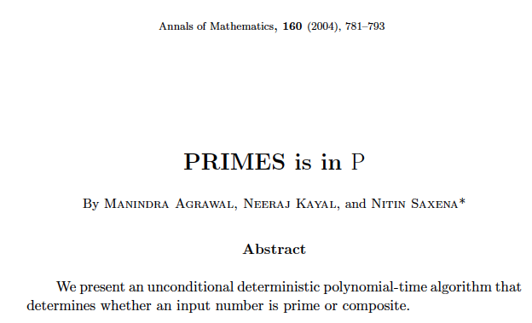
Primality Testing: n
O(log ^{7.5} n)

Slide 26
We have to be very careful when addressing the “size” of an instance.

Slide 27
Time Complexity: Input length
Time complexity of an algorithm is defined in terms of input length
Sorting problem: 5 integers
3, 5, 8, 12, 6 (decimal) length = 6
11, 101, 1000, 1100, 110 (binary) length = 16
111, 11111, 11111111, 111111111111, 111111 (unary) length = 24

Slide 28
Time Complexity: Input length
Time complexity of an algorithm is defined in terms of input length instead of the number of items.
Consider the binary encoding of some input instance for sorting problem: x₁, x₂, …, x_{n}.
The input length is
Clearly, the length l₂ is not less than n.

Slide 29
Time Complexity: Input length
Consider the unary encoding of some input instance for sorting problem: x₁, x₂, …, x_{n}.
The input length is
Similarly, the length l₁ is not less than n.

Slide 30
Lengths under different encoding schemes
Length (decimal) ≦ Length (binary) ≦ Length (unary)
Usually we adopt the decimal length.
Sorting: O(n log n) is polynomial in terms of n, the number of integers.
For a (theoretically) precise definition, we adopt the binary and unary encoding schemes

Slide 31
Time Complexity: Input length
O(n log n) of a sorting algorithm is polynomial in terms of n.
O(n log n) is of course also polynomial in terms of
or

Slide 32
Input Length
Given any instance I in domain D_{Π} of problem Π, Length[I] gives the number of symbols used to describe I under some reasonable encoding scheme (e.g. binary or unary encoding).
Max[I] gives the magnitude of the largest number in I.
Two length functions Length and Length’ for a problem Π are said to be polynomially related if there exists polynomials p and p’ such that for all instances I in domain D_{Π},
Length[I] ≦ p’(Length’[I]), and
Length’[I] ≦ p(Length[I]).

Slide 33
Partition : Instance I consists of a finite set A and a size s(a_{i}) for each a_{i} in A. Is there a partition A₁ and A₂ of A such that ?

Slide 34
The pair of functions (Length[I], Max[I]) is polynomially related to the pair of functions (Length’[I], Max’[I]) if Length(I) and Length’(I) are polynomially related and there exist two-variable polynomials q and q’ such that for all instances I in D_{Π},
Max[I] ≦ q’(Length’[I], Max’[I]), and
Max’[I] ≦ q (Length[I], Max[I]).

Slide 35
Many decision problems have the properties that Max[I] is bounded by a polynomial function of Length[I].
For these problems, there is no distinction between polynomial time algorithms and pseudo-polynomial time algorithms.
A problem Π is called a number problem if there exists no polynomial p such that for all instances I in D_{Π}
Max[I] ≦ p(Length [I])
Question: Is PARTITION a number problem? What about the TSP?

Slide 36
NP-completeness in the strong sense
If an algorithm for a problem Π is polynomial in Length(I), and an upper bound given on the numbers of any instance I is a polynomial in Length(I), then this algorithm is polynomial
An algorithm that solves a problem Π is pseudo-polynomial for Π if its time complexity function is bounded above by a polynomial function of the two variables Max[I] and Length[I]

Slide 37
NP-completeness in the strong sense
If Π is NP-complete and Π is NOT a number problem, then Π cannot be solved by a pseudo-polynomial time algorithm unless P=NP
For any decision problem Π and any polynomial p (over the integers), let Π_{p} denote the subproblem of Π obtained by restricting Π to only those instance I that satisfy Max[I] ≦ p(Length [I])
Then, Π_{p} is not a number problem
If Π is solvable in pseudo-polynomial time, then Π_{p} is solvable in polynomial time

Slide 38
NP-completeness in the strong sense
Problem Π is NP-complete in the strong sense, if Π belongs to NP and there exists a polynomial over the integers for which Π_{p} is NP-complete
If problem Π is NP-complete in the strong sense, then Π cannot be solved in pseudo-polynomial unless P=NP
To prove the strong NP-completeness of a number problem Π, we may either
Perform a reduction a known strongly NP-hard problem, or
Show, for some specific polynomial p, that Π_{p} is NP-complete

Slide 39
TSP is strongly NP-complete because
Hamiltonian Circuit (HC) is NP-complete
HC is a polynomially restricted case of TSP
Max[I] in HC is bounded by a polynomial function of Length[I]
Max[I] = n because we ask the question as in the TSP : Is there a feasible TSP tour whose total length is less than or equal to n?

Slide 40
Scheduling problem with step-deterioration processing time
n jobs: 1, 2, …j, …, n
A common milestone D
If job j starts before D, its processing time is a_j, otherwise a_j+b_j
We want to find a schedule such that the sum of completion times of all jobs is minimum
The problem is NP-complete
Whether it is strongly NP-hard or not remains open

Slide 41
Consider the binary encoding of some input instance for the Partition problem: a₁, a₂, …, a_{n}.
The input length is
which is no greater than “n log max{s(a_{i})}”.
There exists some algorithm that attains a time complexity of O(nΣs(a_{i})), which is smaller than O(n² max{s(a_{i})})
The time complexity is exponential!
Or, we say it is pseudo-polynomial.

Slide 42
Complexity Hierarchy
Polynomial
NPI (NP-intermediate)
NP-Complete
Pseudo-polynomial
Exponential
… Far far beyond

Slide 43
Is linear programming (LP) solvable in polynomial time?
x₂
Linear Program
Maximize Z = 3x₁ + 5x₂
subject to
x₁ ≤ 4
2x₂ ≤ 12
3x₁ + 2x₂ ≤ 18
x₁ ≥ 0, x₂ ≥ 0
(2, 6)
(0, 6)
Feasible
region
(4, 3)
(0, 0)
(4, 0)
x₁

Slide 44
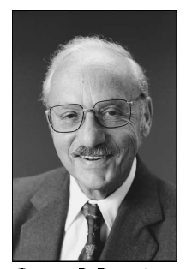
Is linear programming (LP) solvable in polynomial time?
If we examine the feasible corner points one by one, then the number of iterations would be exponential in the number of decision variables
Simplex method is practically efficient and theoretically beautiful. Unfortunately, the running time of simplex method could be given in the objective values
George Danzig
(1914 – 2005)

Slide 45
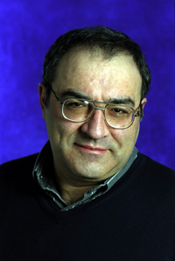

Two Milestones in LP
1979: Leonid Khachian (1962-2005) proposed the ellipsoid algorithm that can solve linear programs in polynomial time
1984: Narendra Karmarkar developed interior method that is very fast in practice

Slide 46
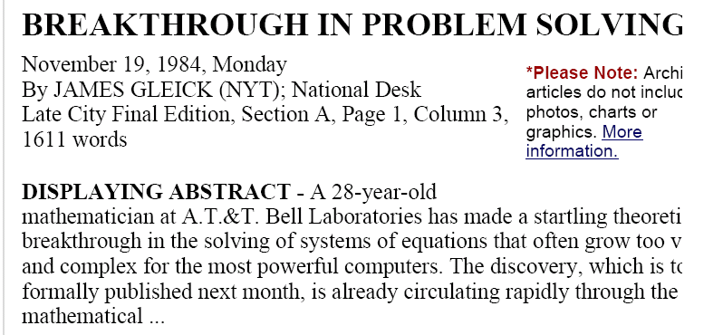

Slide 47
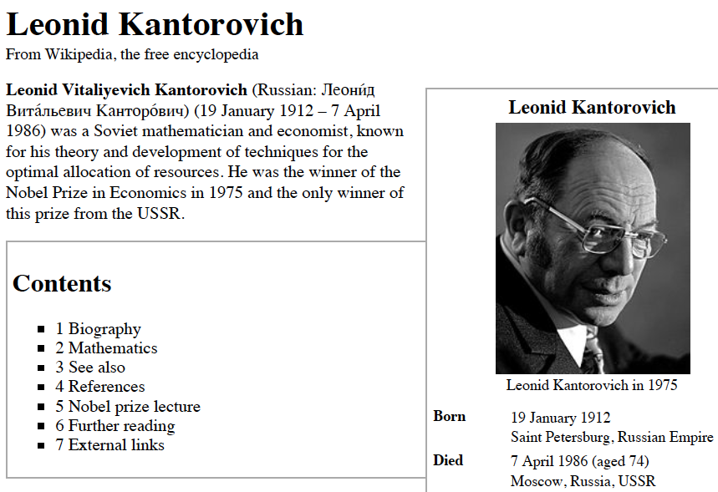
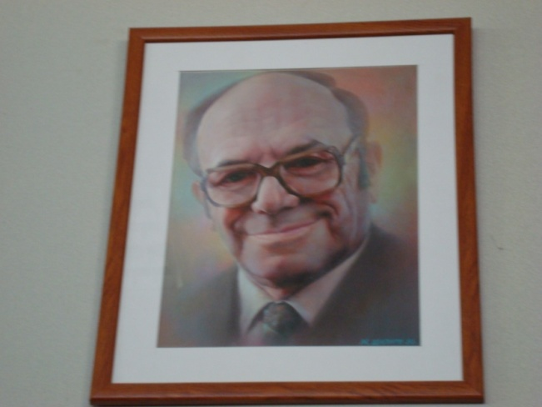
The Prize in Economic Sciences 1975 L.V. Kantorovich and T.C. Koopmans
The Sveriges Riksbank Prize in Economic Sciences in Memory of Alfred Nobel

Slide 48
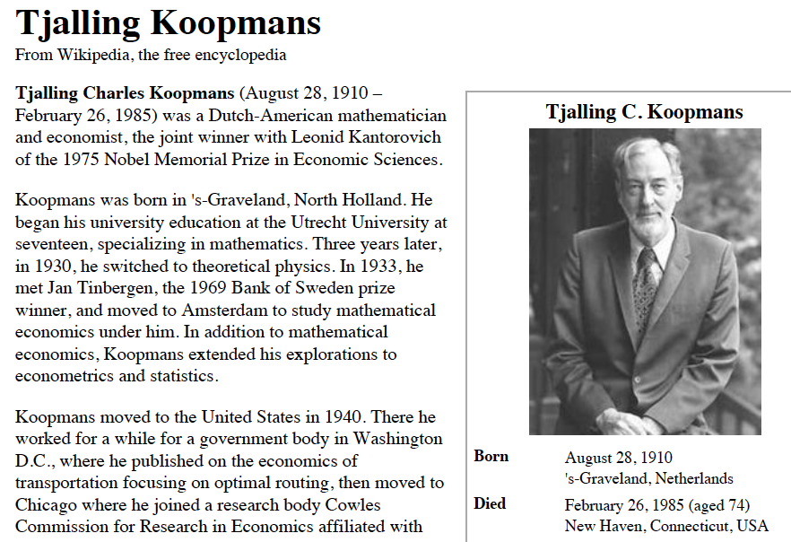
The Prize in Economic Sciences 1975 L. V. Kantorovich and T.C. Koopmans
The Sveriges Riksbank Prize in Economic Sciences in Memory of Alfred Nobel

Slide 49
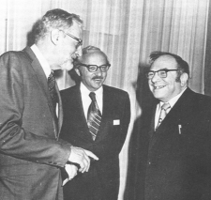
Koopmans, Dantzig, Kantorovich (1976)
-- from “On the Shoulders of Giants”: A brief excursion into the history of mathematical programming 1” by R. Tichatschke

Slide 50
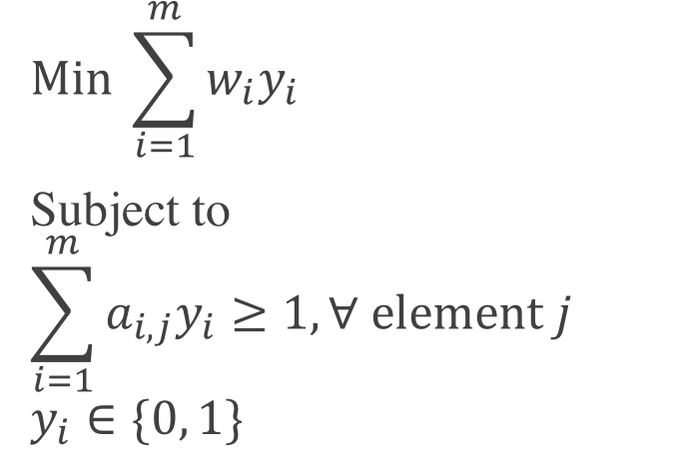
Weighted Set Cover
A set S={1, 2, …, n} and a collection of its subsets S₁, S₂, …, S_{m} with weights w₁, w₂, …, w_{m}
We want to find the minimum weighted cover
Decision variables: y_{i} =1 if subset S_{i} is selected; 0, otherwise
$$Min \sum_{i=1}^{m}{w_{i}y_{i}}$$
Subject to
$$\sum_{i=1}^{m}{{a_{i,j}y}_{i}≥1, ∀ element j}$$
$$y_{i}∈\{0, 1\}$$
Known cofficient a_{i,j}=1, if element
j is in set S_{i}

Slide 51
Meters Cover
A set S={1, 2, …, n} and a collection of its subsets S₁, S₂, …, S_{m}
Each subset S_{i} (receiver at some pole) is associated with a weight w_{i} and a capacity C_{i}
We want to find the minimum weighted cover subject to two constraints: capacity and coverage
Decision variables:
y_{i}: 1 if subset S_{i} is selected; 0, otherwise.
x_{i,j} : 1 if meter j is covered by pole S_{i}; 0, otherwise.

Slide 52
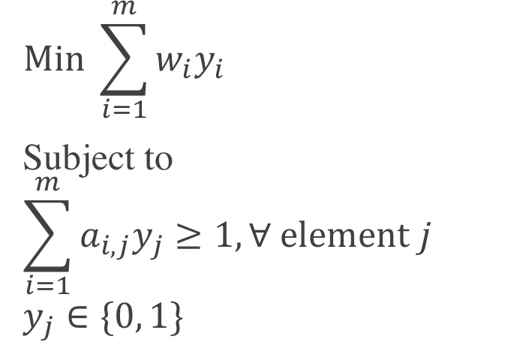
Meters Cover
$$Min \sum_{i=1}^{m}{w_{i}y_{i}}$$
Subject to
$$\sum_{i=1}^{m}{{a_{i,j}y}_{j}≥1, ∀ element j}$$
$$y_{j}∈\{0, 1\}$$
C_{k}Y_{k}

Slide 53
Minimization of the Number of Tardy Jobs (Order Fill Rate, ORG)
There are n jobs 1, 2, …, n to process on a single machine
Each job j has a processing length p_{j}, a release date r_{j} and a due-date d_{j}
The machine can process a job at a time
We want to find a job sequence such that the number of tardy jobs is minimum

Slide 54
Models with Different Decision Variables (Dauzere-Peres and Sevaux 1998)
Sequencing decision variables:
job i precedes job j or not
Positional decision variables:
job i is at the k^{th} position
Time-indexed decision variables:
job i starts at time t

Slide 55
